Slide 1

Introduction to OOP

Slide 2

Classes & Objects

Slide 3
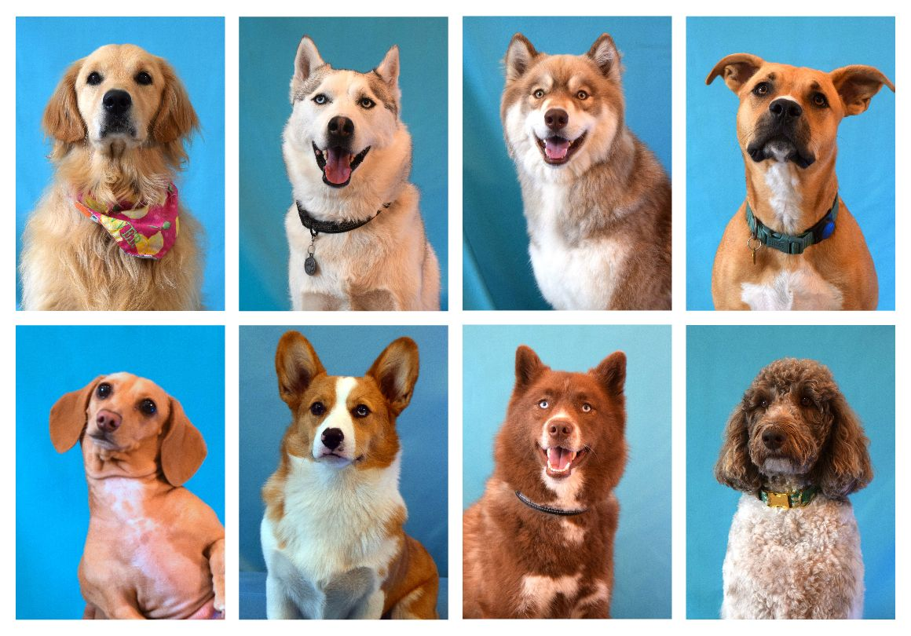
Catalog of dogs in your neighborhood
Properties:
Name
Age
Type
Sex
Address
Preferable park
Notes:
Let’s assume we want to create a catalog of all the dogs in a neighborhood. Each dog has several parameters in common that describe it, for example: name, age, type, and so on.

Slide 4

Class: Dog
class Dog
{
string name;
int age;
string type;
char sex; // f – female, m - male
string address;
string preferablePark;
}
Dog dog1; // instance
Dog dog2; // instance
Dog[] dogs = {dog1, dog2}
*Not actual code
Notes:
We will create something called a class, a kind of “template” for every dog we want to represent. Each time we want to create a new dog, we will use the template we created and define the specific parameters for that dog. This process is called instantiation, and each dog we describe is an “object.” Now we can store an array of objects of type Dog.

Slide 5

Catalog of cats in your neighborhood
Properties:
Name
Age
Type
Sex
Address
Preferable chair
Notes:
Now suppose we want to create a catalog of all the cats in the neighborhood. Each cat, just like each dog, has several shared parameters that describe it, for example: name, age, type, and so on.

Slide 6

Class: Cat
class Cat
{
string name;
int age;
string type;
char sex; // f – female, m - male
string address;
string preferableChair;
}
Cat cat1 ; // instance
Cat cat1 ; // instance
Cat[] cats = {cat1, cat2}
*Not actual code
Notes:
We will repeat exactly the same steps: create a class of type Cat and then create several objects of type Cat using instantiation.
If you notice, the only difference between the Dog class and the Cat class is that cats don’t go to parks but instead prefer a certain chair at home.

Slide 7
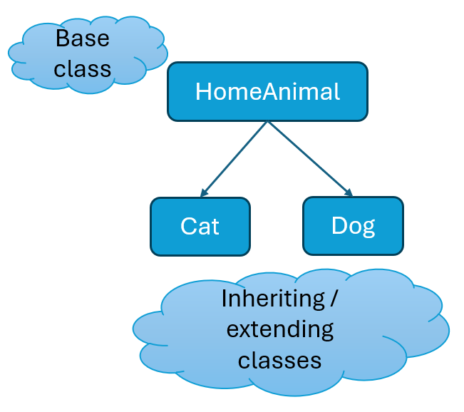
Base class HomeAnimal
class HomeAnimal
{
string name;
int age;
string type;
char sex;
string address;
}
class Cat extends Animal
{
string preferableChair;
}
class Dog extends Animal
{
string preferablePark;
}
*Not actual code
Notes:
We will create something called a base class that contains the parameters shared by both cats and dogs.
The Cat class and the Dog class will inherit from our base class. This means that all the properties and methods found in the base class will also exist in the Cat class and the Dog class, in addition to specific properties found only in the Dog or Cat classes.

Slide 8
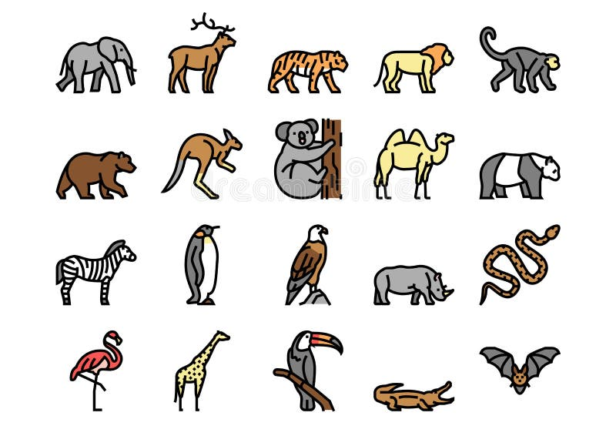
Build a catalog for the full zoo

Slide 9
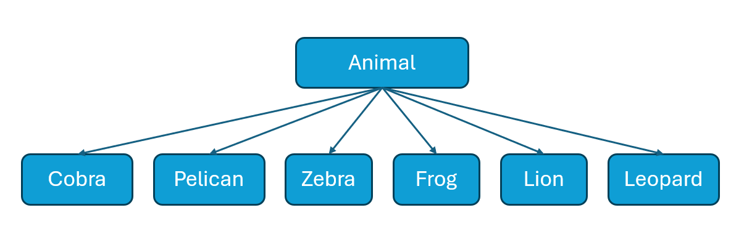
One level of inheritance / extension
Notes:
One option is to do what we did with dogs and cats: create a single base class that everything inherits from.

Slide 10
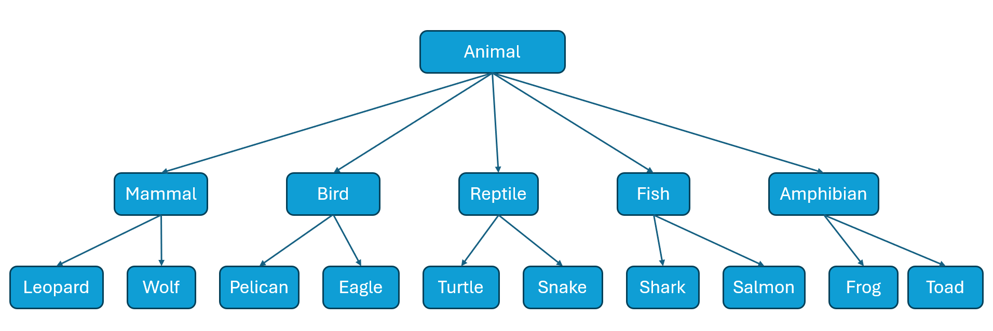
Multiple levels of inheritance /extension
Animal[] animals = {animal1, animal2}
*Not actual code
Notes:
Another option is to create multiple levels of inheritance.

Slide 11

Syntax Java

Slide 12
Create a Class
public class ClassName
{
private int name;
private int age;
public ClassName(int name, int age) {
this.name = name;
this.age = age;
}
public double estimateHeight() {
return this.age * 0.2;
}
}
Properties
Contractor
Functions
Notes:
Source: https://www.w3schools.com/java/java_oop.asp
A constructor is used when we want to create a new instance of our class.

Slide 13
Inherit a Class
public class ClassName extends ParentClass
{
private int weight;
public ClassName(int name, int age, int weight) {
super(name, age);
this.weight = weight;
}
}
New unique Properties
Constructor
Notes:
Source: https://www.w3schools.com/java/java_oop.asp

Slide 14
Public – Protected - Private
In Java, we use access modifiers to control the visibility and accessibility of class properties (variables) and methods (functions). The three main access modifiers are:
Public - Members defined as public are accessible (read & write) from anywhere in the program, including classes in other packages.
Protected – Members defined as protected are accessible only within the same class and class that inherit it.
Private – Members defined as private are accessible only within the same class.
Notes:
Source: https://www.w3schools.com/java/java_oop.asp

Slide 15

Practice

Slide 16
Animals catalog

Slide 17
Classes Examples
Animal
Properties:
private name
private age
private height
private static animalsCount
Functions:
string getName()
int getAge()
double getHeight()
Wolf
Properties:
private packSize
Functions:
int getPackSize()

Slide 18
Overrides
In Java, method overriding occurs when a subclass provides a specific implementation for a method already defined in its parent class.
The overridden method in the subclass must have the same name, return type, and parameters as the method in the parent class.
Overrides are used to modify or extend the behavior of a method for a specific subclass.
The @Override annotation indicates that a method is being overridden.
It is optional but recommended because it helps avoid mistakes (e.g., typos in the method name) and improves code readability.
The super keyword is used to call the parent class's version of a method or constructor.

Slide 19
Overrides
public class Animal
{
private static int animalsCount;
public void animalSound() {
System.out.print(“The animal makes the sound: “)
}
}
Original function inside the base class
public class Leopard extends Mammal
{
@Override
public void animalSound() {
super.animalSound();
System.out.println(“Growl”)
}
}
Override the function
Notes:
Source: https://www.w3schools.com/java/java_oop.asp

